Slide 1




Public Engagement Webinar
28th April, 2021
Prepared for:
Prepared by: Ian McShane
J.202383

Slide 2
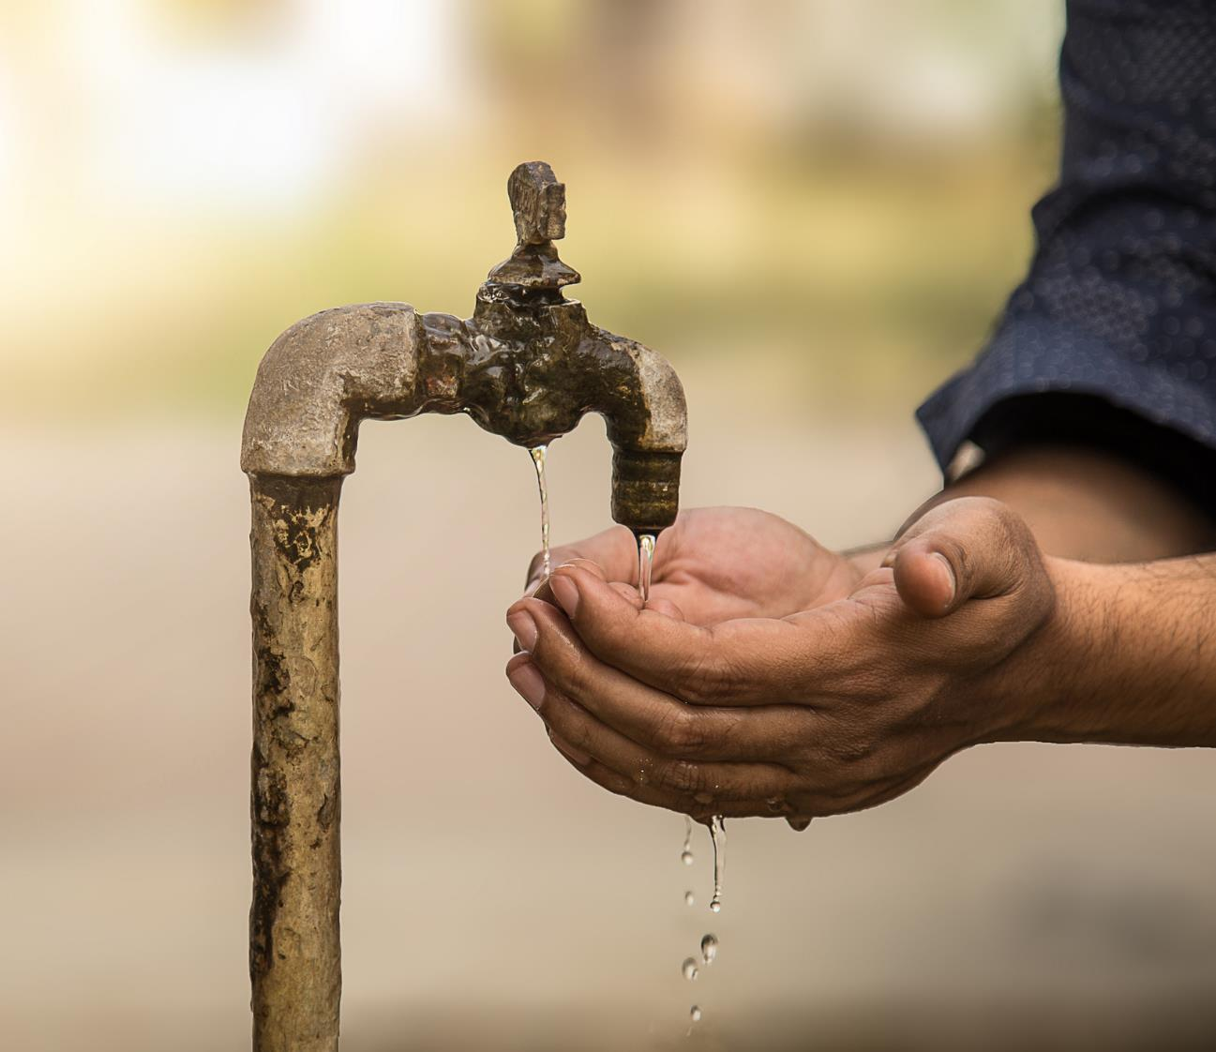
Levels of Concern about Poverty in Developing Countries
Base: All Adults N - 3,008
Concern around levels of poverty in developing countries
N - 3008
%
Very concerned
Fairly concerned
No strong feelings either one way or the other
Not very concerned
Not at all concerned
NET (Concerned) 75%
NET (not Concerned) 5%
Q.29 Which of the following best describes how you feel about levels of poverty in developing countries?

Slide 3
Importance Of Irish Government Providing Overseas Aid
Base: All Adults N – 3,008
NET
NOT IMPORTANT
%
NET IMPORTANT
Don’t know
Not at all important
Net worse
14%
Net better
54%
Not very important
Very important
19%
77%
Fairly important
Q.33 Do you feel it is very important, fairly important, not very important or not at all important that the Irish Government provides overseas aid to help people in developing countries?

Slide 4
Should Irish Government Increase Or Decrease The Amount Of Money It Spends On Overseas Aid
Base: All Adults N – 3,008
NET
DECREASE
%
NET INCREASE
Don’t know
Increase a great deal
Net worse
14%
Decrease a great deal
Net better
54%
Increase somewhat
21%
Decrease somewhat
31%
Stay the same
Q.32 Do you think that the Irish Government should increase or decrease the amount of money that it spends on overseas aid to developing countries?

Slide 5

Level Of Agreement That Citizens Of Ireland Have A Moral Obligation To Personally Support Overseas Aid
Base: All Adults N – 3,008
Total
N - 3008
%
Strongly agree
Agree
Neither agree nor disagree
Disagree
Strongly disagree
NET (Agree) 60%
NET (Disagree) 12%
Q.34 Overseas aid focuses on longer-term goals such as poverty-alleviation and tackling inequality. To what extent do you agree or disagree that citizens of Ireland have a moral obligation to personally support overseas aid?

Slide 6
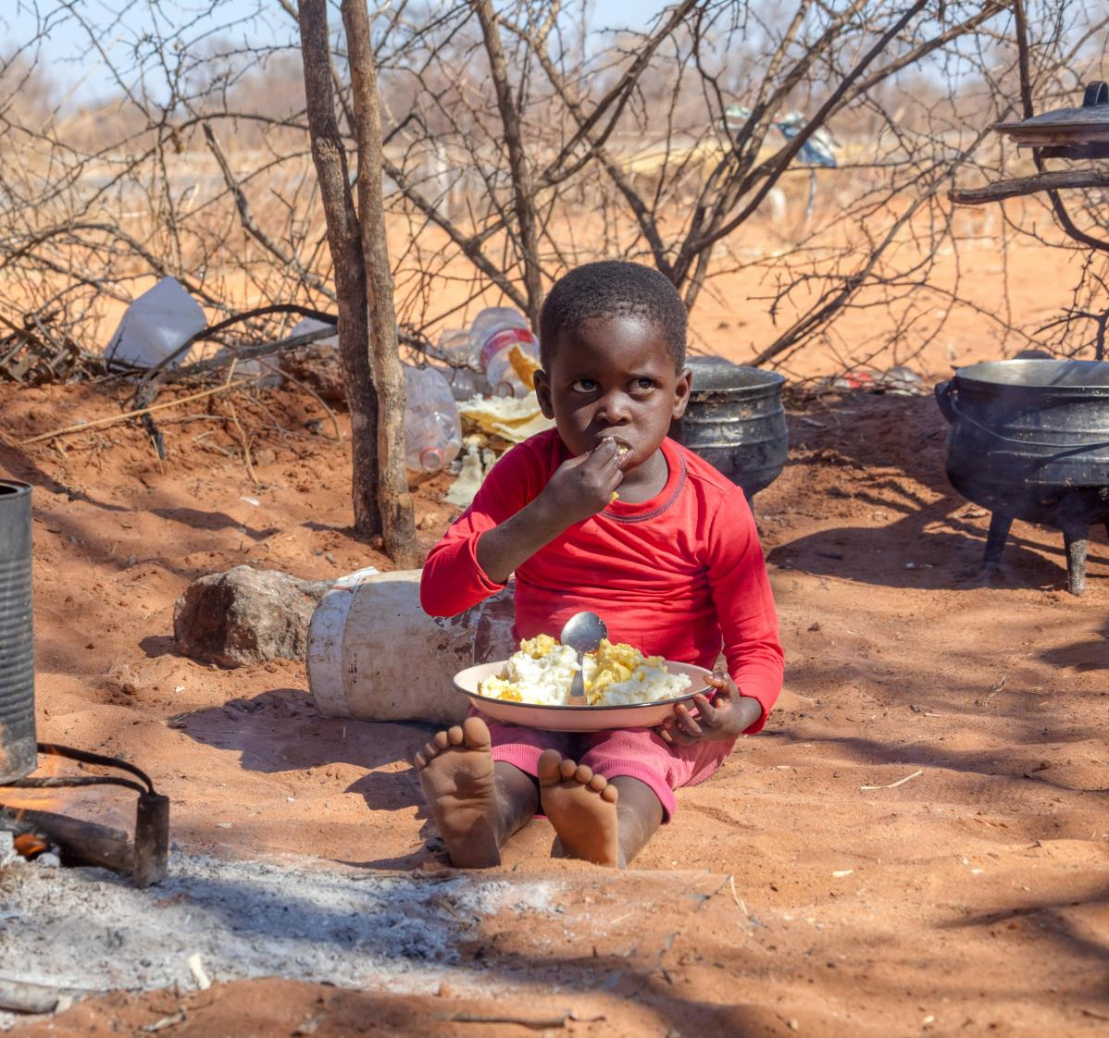

Level of agreement that Overseas aid can help bring about positive change for those living in developing countries
Base: All Adults N - 3,008
Total
N - 3008
%
Strongly agree
Agree
Neither agree nor disagree
Disagree
Strongly disagree
NET (Agree) 79%
NET (Disagree) 6%
Q.35 Please indicate the extent to which you agree or disagree with the following statement. Overseas aid can help bring about positive change for those living in developing countries.

Slide 7



Underlying Barriers to Overseas Development Aid
At a qualitative level, there is clearly a set of interrelated factors that can act as real or potential barriers to supporting or advocating for ODA. For many, these factors unfold in their minds as a linear narrative as they consider the issue.
The efficacy of ODA administered
How exactly is the ODA administered and by who?
Corruption in development countries
Many do not have a clear idea as to precisely what areas ODA is allocated to, other than short term humanitarian purposes.
Even where there is an understanding of what the money is spent on, how do we know the expenditure has been effective?
People’s thinking is decidedly hazy as to the precise role the likes of the Irish Government, multilaterals and development organisations play in administering aid.
Giving rise to serious concerns around the % of ODA that actually reaches its destination, by the time all administration costs have been accounted for.
With such uncertainty as to how exactly ODA is managed from the time it ‘leaves’ its country of origin, it is no wonder that many are concerned around checks and balance that would mitigate against monies being misappropriated by corrupt officials in the developing countries.

Slide 8




Overseas Aid – Value Motivators
To a significant extent, the reasons people feel motivated to help those in developing countries worse off than ourselves exist in the sub-conscious in psychological ‘clusters’, with values in each cluster often meaning the same thing to many people.
Humanitarianism/Shared humanity/Human rights
Justice/Morality
Solidarity
Duty/Care/Sympathy
NB: people motivated by these values are by no means only referring to more short term humanitarian aid.
The over-riding sentiment here is that of all individuals, regardless of their circumstances or geography, having equal rights to basic human requirements such as food, water, shelter and civil liberties.
Underpinned by a belief that we are all part of a global society.
Regardless of the causes of the challenges faced by developing countries, a belief that we, as more privileged individuals due to a quirk as to where we were born, have a moral duty to help those less fortunate than ourselves.
A belief held even more strongly by those who feel more powerful countries are a key cause of such poverty.
Linked in the minds of some to justice, this value is often cited by the minority who feel that the Irish have a special duty of care to developing countries due to our own history of famine and colonialism.
Tending to be identified by older, more C2DE adults, those who may be motivated by these values are also more inclined to believe that the citizens of such counties are at least partly responsible for their own misfortune.

Slide 9




Government Aid Support Priorities – Qualitative Overview
Something of a hierarchy emerged from the focus groups as to how people felt Government aid should best be spent.
HEALTH
EDUCATION
Literally a “life and death” short term benefit to the recipient
On the basis that strong economies and democracies are built on education
Whether supplying medicines, sending medical professionals, or building hospitals.
Basic reading, writing, arithmetic with full access to girls/women
Also industrial, construction, agricultural, etc. Training
INFRASTRUCTURE
Roads, transport, networks, irrigation, sewage
SUSTAINABILITY/ALTERNATIVE ENERGY SOURCES
e.g. solar energy to power industry and commerce. Reduce reliance on richer country, oil, etc.

Slide 10
How Much Of A Difference Can The Following Make To Reduce Poverty In Poor Countries
Base: All Adults N – 3,008
The United Nations and other international organisations | Businesses/ corporations | Development Organisations/ charities | The Irish government | You personally
% | % | % | % | %
(9 - 10 score)
(7 - 8 score)
(0 - 6 score)
Mean
Q.51-55 How much of a difference, if any, do you think each of the following can make to reducing poverty in poor countries ?

Slide 11


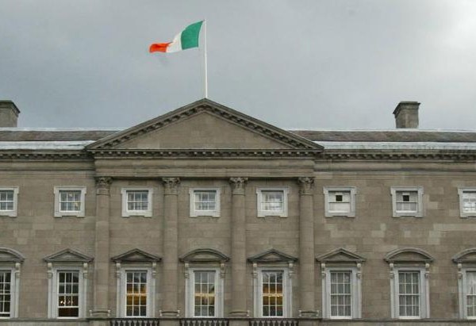

Trust
Base: All Adults N – 3,008
People you have contact with
%
Multilateral organisations (EU and UN)
%
Irish Government
%
Overseas development aid organisations
%
10 - Trust a great deal
(9 - 10 score)
(7 - 8 score)
(0 - 6 score)
0 - Do not trust at all
Mean score
6.92
5.68
5.15
4.83
Q.47 - 50 To what extent do you trust ____________on a scale from 0 to 10 where 0 means you do not trust them at all and 10 means you trust them a great deal?

Slide 12


Segmentation Analysis

Slide 13
Segments – Demographic Overview
More highly engaged
Global Citizens - 19% 712,000 individuals
20-39, Single/Pre-Family, ABC1,
Urban, college educated.
Community Activists - 10% 370,000 individuals
Single/Young Family, College/Post Grad,
Female skew.
European Multilateralists - 21%
778,000 individuals
Urban, ABC1, 55+
Younger
Older
National Pragmatists - 15%
566,000 individuals
C2DE, 60+, Empty Nester.
Empathetic Reactionaries - 25%
918,000 individuals
Female, 18-34, Young Family
C2DE skew.
Disengaged Nationalists - 10%
367,000 individuals
Male, 25-44.
Less highly engaged

Slide 14
Global Citizens – Overseas Aid Profile
Minority Rights Concern
Developing Country Poverty Concern
Developing Countries Capability
19%
of All Adults
Total
Global Citizens
Total
Global Citizens
Total
Global Citizens
712,000 individuals
Trust – Top 10 Rating
Reasons to help Developing Countries
Causes of Poverty in Developing Countries
Irish Government Support Priorities
Health
Education
Water
Governance
Economic Growth
Social Protection
Environmental Protection
Migration & refugee flows
Global Citizens is strongly inclined towards the view that developing countries can make progress given the right support and are deeply concerned about poverty in such countries at a personal level. This segment also places more trust than average in overseas aid organisations and multi-lateral organisations, and its motivation to help developing countries is based on a broad mix of values and sentiments. This segment is also quite critical of more powerful countries, and their role over the years in propagating poverty in developing countries.

Slide 15
Community Activists – Overseas Aid Profile
Minority Rights Concern
Developing Country Poverty Concern
Developing Countries Capability
10%
of All Adults
Total
Community Activists
Total
Community Activists
Total
Community Activists
370,000 individuals
Trust – Top 10 Rating
Reasons to help Developing Countries
Causes of Poverty in Developing Countries
Irish Government Support Priorities
Government and private sector corruption in those countries
War and conflict
Government inefficiency or incompetence
Rich countries tend to exploit developing countries
Weak institutions in those countries
The global economic system favours richer countries
Wealthy countries support authoritarian regimes for their own political interests
High debt burden for developing countries
Legacy of colonialism
Health
Education
Water
Governance
Economic Growth
Women's Equality
Migration & refugee flows
Practically all individuals in Community Activists express concern about poverty in developing countries, with approaching three-quarters of them of the view that such countries can make real progress with the correct supports in place. Motivated to support helping developing countries on the basis of basic human rights and a sense of shared humanity, this segment attributes poverty in those countries to the behaviour and policies of wealthy, powerful, countries.

Slide 16
European Multilateralists – Overseas Aid Profile
21%
of All Adults
Minority Rights Concern
Developing Country Poverty Concern
Developing Countries Capability
Total
European Multilateralists
Total
European Multilateralists
Total
European Multilateralists
778,000 individuals
Trust – Top 10 Rating
Reasons to help Developing Countries
Causes of Poverty in Developing Countries
Irish Government Support Priorities
Total
European Multilateralists
Total
European Multilateralists
Total
European Multilateralists
European Multilateralists
Total
Health
Education
Water
Governance
Economic Growth
Women's Equality
The vast majority of those in European Multilateralists are concerned about poverty in developing countries and are more inclined than the average individual to support aid to developing countries due to a sense of justice and morality. Attributing poverty in developing countries to a mix of causes, these individuals indicate high levels of trust in multi-lateral organisations like the EU and UN , compared to other relevant bodies.

Slide 17
Disengaged Nationalists – Overseas Aid Profile
Minority Rights Concern
Developing Country Poverty Concern
Developing Countries Capability
10%
of All Adults
Total
Disengaged Nationalists
Total
Disengaged Nationalists
Total
Disengaged Nationalists
367,000 individuals
Trust – Top 10 Rating
Reasons to help Developing Countries
Causes of Poverty in Developing Countries
Irish Government Support Priorities
Health
Education
Water
Governance
Economic Growth
Infrastructure
Family planning
Entirely unsympathetic to the notion of helping developing countries, Disengaged Nationalists essentially believes that Government incompetence and the irresponsible behaviour of citizens of those countries themselves are the root causes of poverty there.

Slide 18
Segments Targeting Strategy
Global Citizens
Community Activists
European Multilateralists
Bullseye Audience
20-39; Single/Pre-Family. ABC1, Urban, College Educated.
Single/Young Family; College/ Post-graduate; Female Skew.
Urban, ABC1, 55+
Media Channels
Over-index on multi-media digital channels (news sites, social media, podcasts).
Mix of traditional channels (TV; radio; print) and social media.
Full mix of traditional media touchpoints.
Socio Cultural Priorities
Global citizens; focused on climate change, housing, fake news, rise of populism; more positive financial outlook.
Local community/national citizens; focused on housing, climate change, economic inequality, developing countries, populism.
European/National citizens; focus skew towards health service.
Overseas Aid – Communications Messaging
Aid as a humanitarian and moral imperative. Addressing exploitation by powerful countries. Administered by multilaterals and aid organisations.
Aid as basic human right and sense of shared humanity. Addressing a global economic system favouring rich countries.
Aid for reasons of justice and morality. Administered by Irish Governments via Aid Organisations, overseen by Multilaterals.

Slide 19
Segments Targeting Strategy
National Pragmatists
Empathetic Reactionaries
Disengaged Nationalists
Bullseye Audience
60+; C2DE, Empty Nesters
18-34 years, female, young family, C2DE skew
25-44 years, male
Media Channels
Strongly over-index on traditional TV, print and radio
Focus on social media, VOD and consider the power of online influencers.
Disengaged from ‘mainstream;’ media, information campaigns
designed to challenge their own bubbles/echo chambers is key.
Socio Cultural Priorities
Primarily citizens of Ireland, with pessimistic outlook on the economy. Focused on short to medium term national challenges from economy to health service.
Local/national citizens; support a tax less, spend less regime. Over-index on mental health concerns.
Identity viewed through prism of country first, local community second. Grim view of Ireland’s economic and social outlook. Worry about immigration and proliferation of fake news.
Overseas Aid – Communications Messaging
Aid due to a sense of justice and humanitarianism. Concerns around poverty due to corruption and local inefficiencies to be addressed.
Attribute poverty to conflict, disease and insufficient local Government investment. Empathetic to the plight of developing countries. Aid as a basic human right.
Misconceptions around root causes of poverty to be addressed. Aid on basis of sympathy, pity and charity.

Slide 20

Thank you.
Milltown House
Mount Saint Annes
Milltown, Dublin 6 - D06 Y822
+353 1 205 7500 | www.banda.ie

